Slide 1
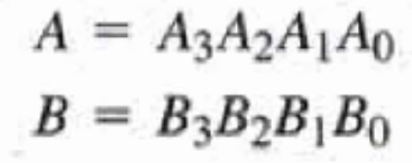
Magnitude Comparator
Is a combinational circuit that compares two numbers A and B and determines their relative magnitudes.
Input: 2 numbers A and B to be compared
Output: 3 bits (A = B, A<B, A>B)
Given two numbers

Slide 2
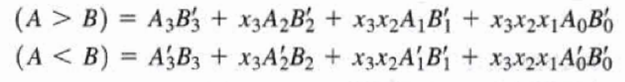
Magnitude Comparator
A = B when A₃ = B₃, A₂ = B₂, A₁ = B₁ and A₀ = B₀
The equality of each pair of bits can be logically expressed using Ex-NOR function as x_{i} = A_{i}B_{i} + A_{i}′B_{i}′ for i = 0, 1, 2, 3
x_{i} = 1 when pair of bits in position i are equal
(A = B) = x₃x₂x₁x₀

Slide 3
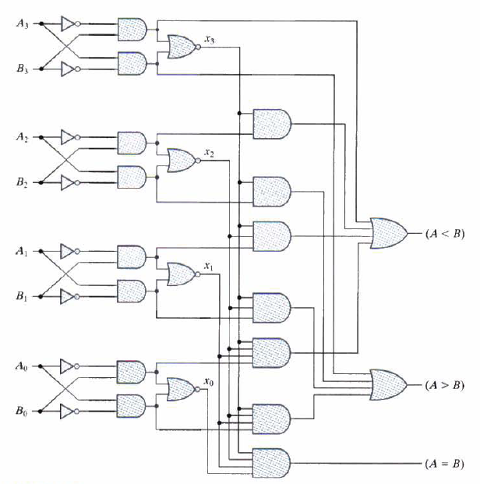
Logic diagram of 4-bit magnitude comparator

Slide 4
References
M. Morris Mano, “Digital Design”, 3rd Edition

